Slide 1
Superstore Data
By Tommy, Eric, John

Slide 2
Data Exploration

Slide 3
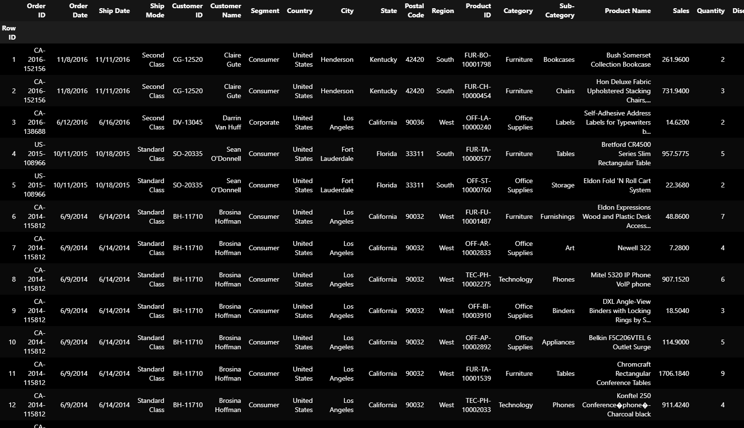
Our data set contains sales data from a superstore. It contains information about the profits, sales, costumer, product being purchased, etc for every order. We got the data set from kaggle and it has close to 10,000 entries.

Slide 4
Questions to ask
Are profits/sales up or down?
What location(s) are performing the best?
What category of items sell the best?
Which categories generate the most profit?

Slide 5
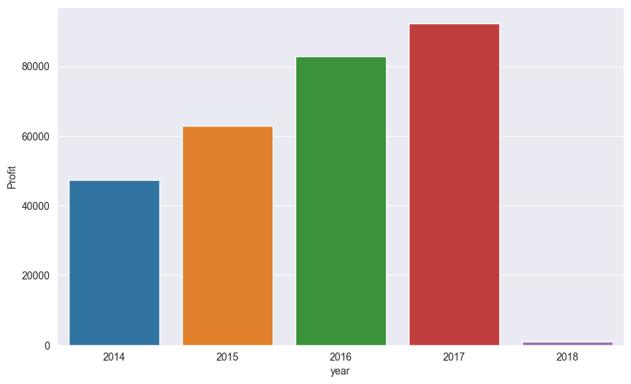
Bar graph of profit over time in years

Slide 6
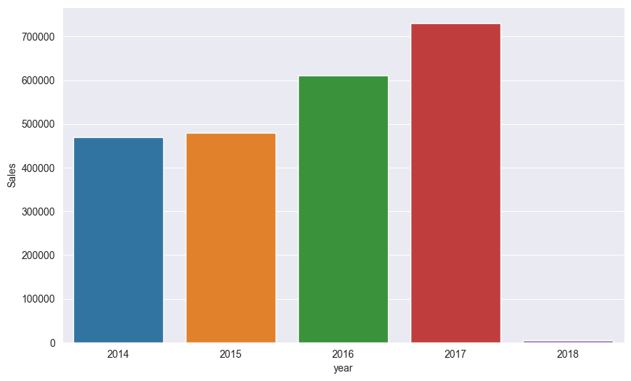
Sales over time in years

Slide 7
Regression

Slide 8
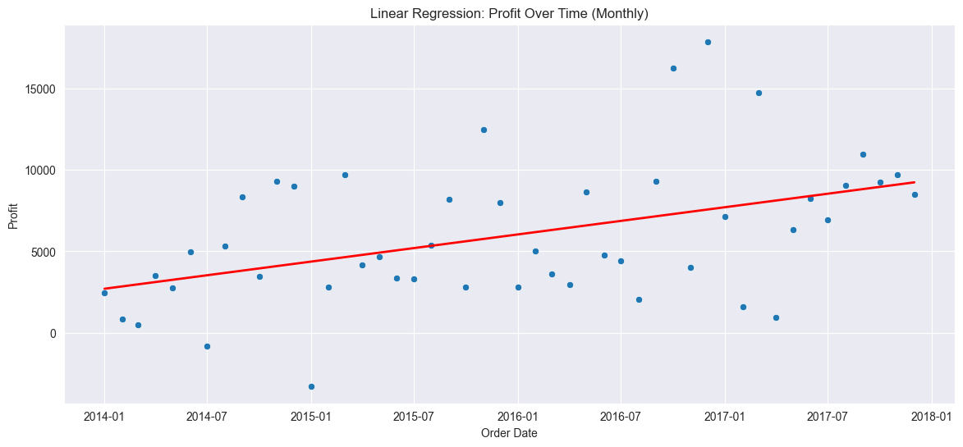
Profit: Yearly Aggregated: Monthly

Slide 9
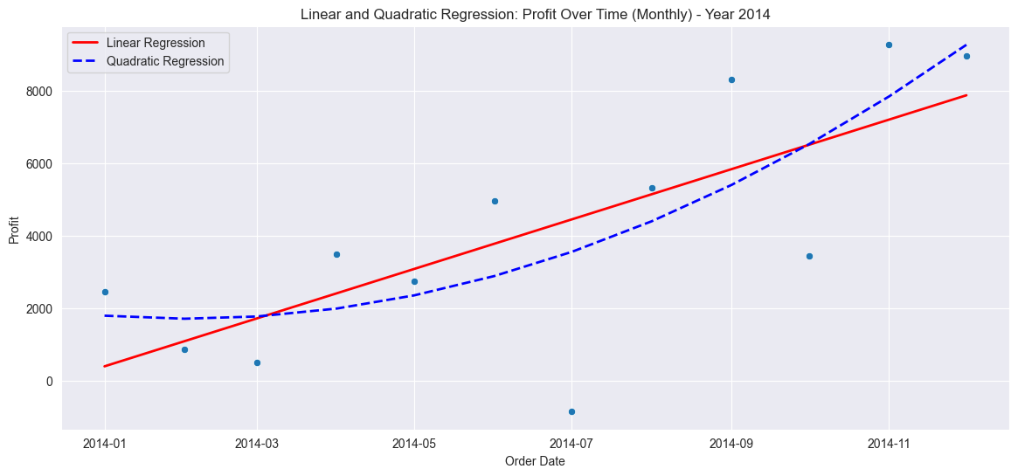
Profit was growing

Slide 10
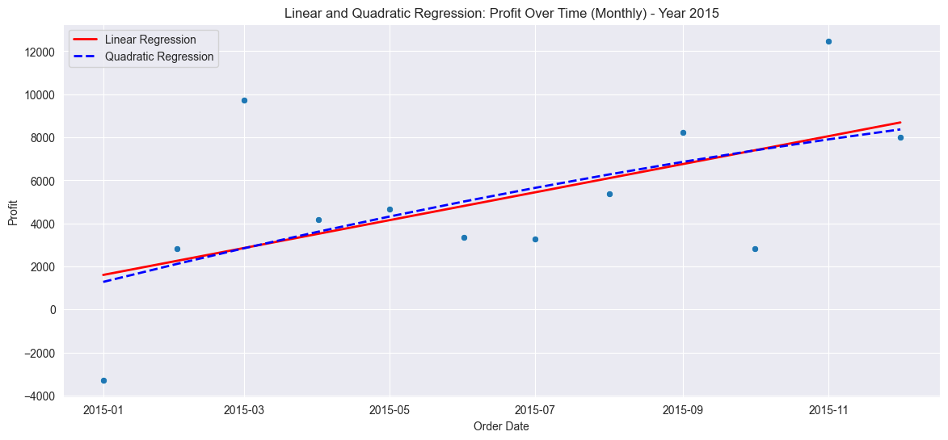
Profit was neutral or declining

Slide 11
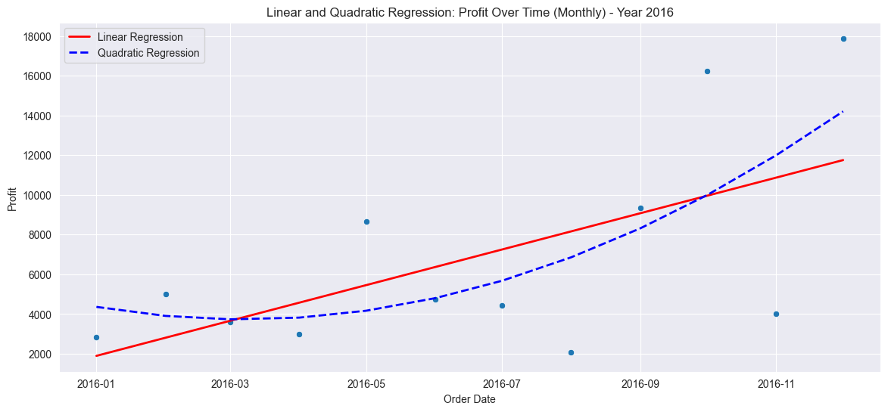
Profit was growing

Slide 12
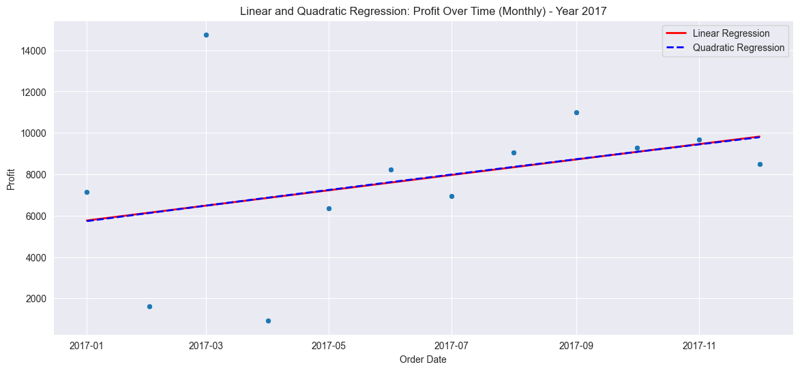
Profit was neutral with minimal growth

Slide 13
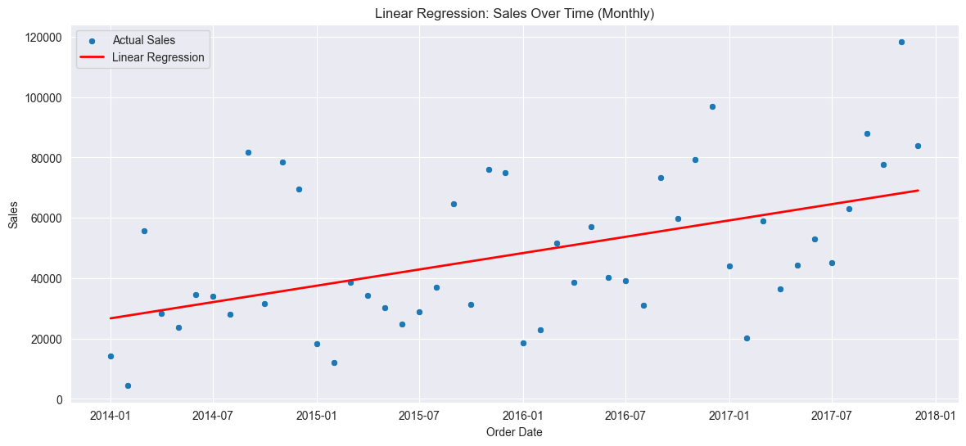
Sales: Yearly
Aggregated: Monthly

Slide 14
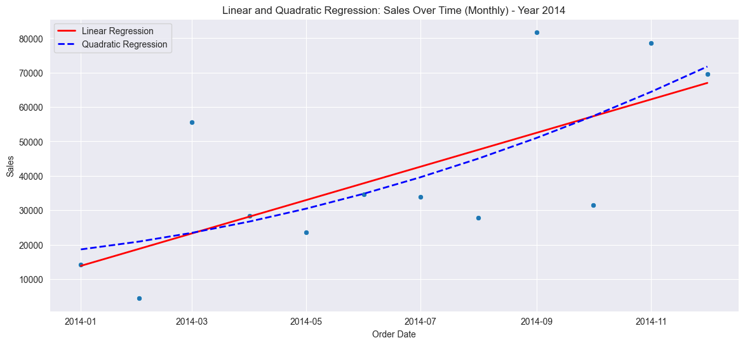
Sales had a slow increase

Slide 15
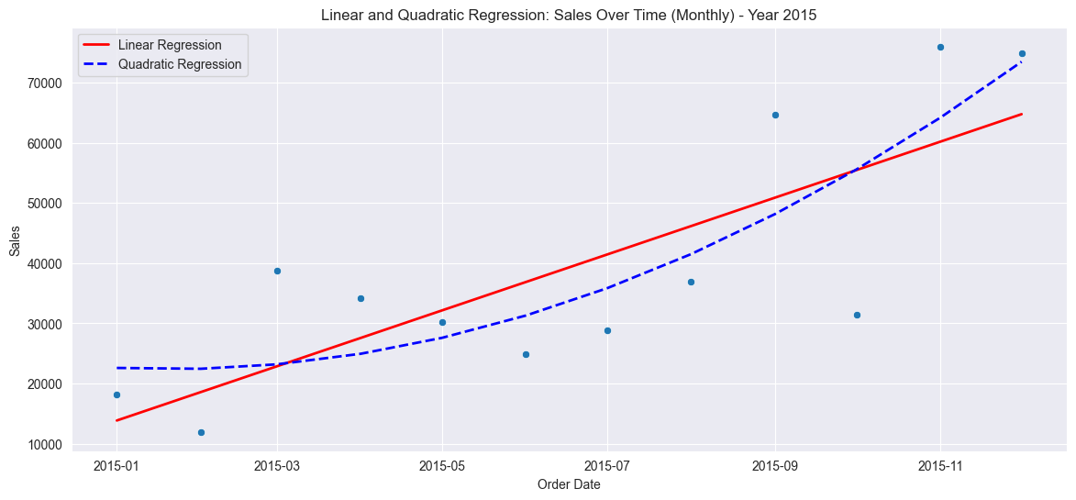
Sales increase dramatically

Slide 16
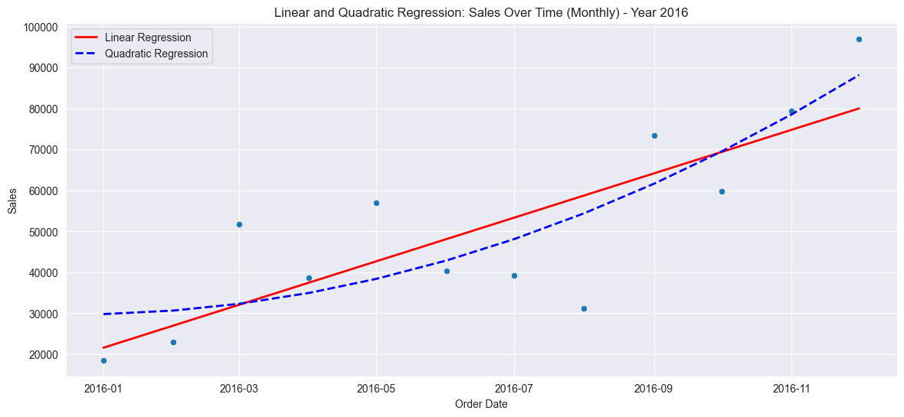
Sales are up

Slide 17
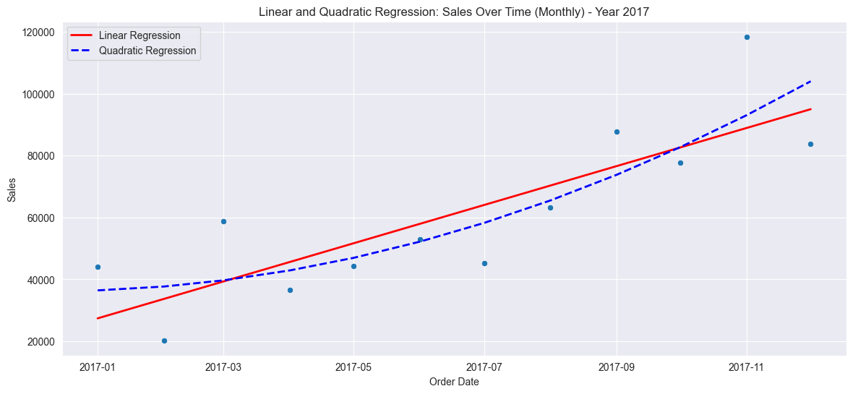
Less of a growth

Slide 18
Regions

Slide 19
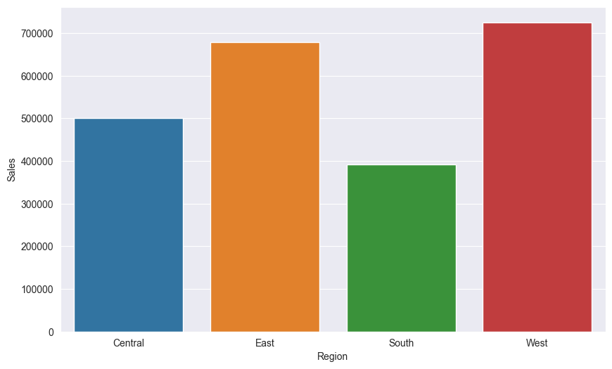
East and West have the most sales

Slide 20
States

Slide 21
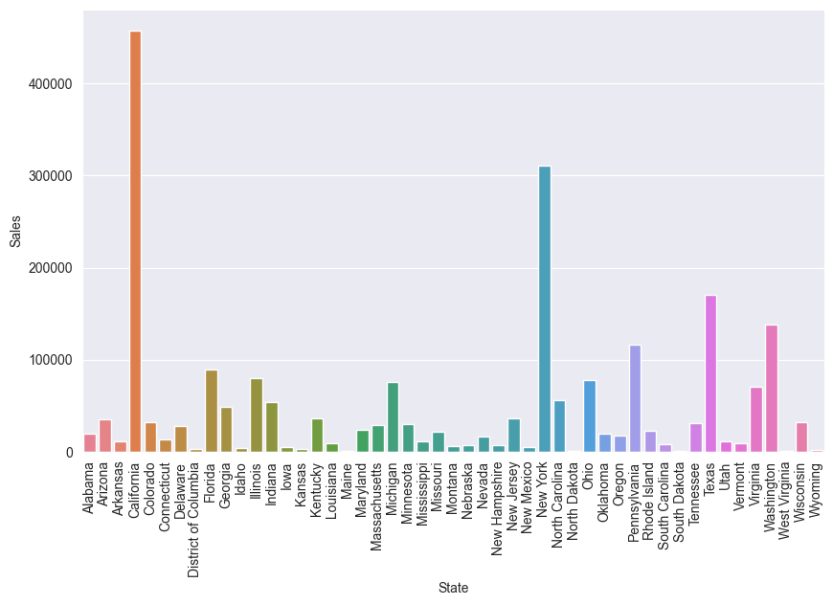
California has the most sales, followed by New York.

Slide 22
Cities

Slide 23
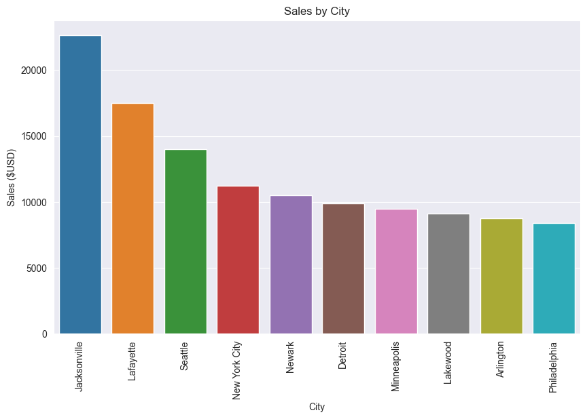
Most sales by City is Jacksonville

Slide 24
Item Sub-category

Slide 25
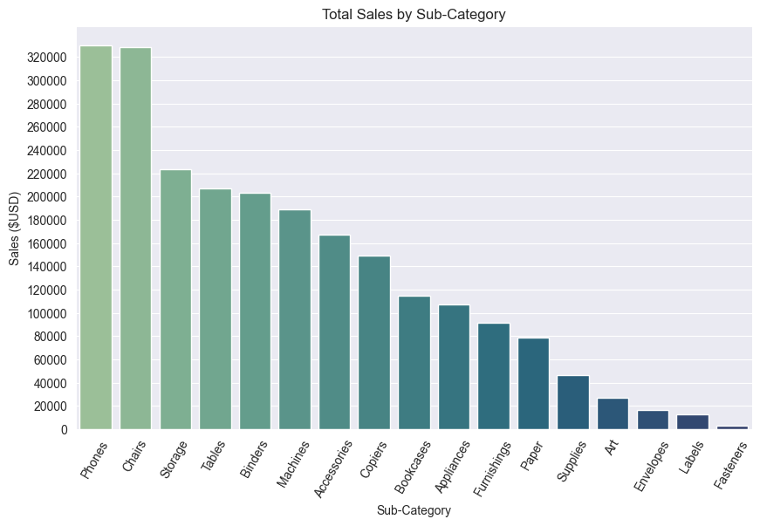
Phones generate the most sales
Fasteners generate the least sales

Slide 26
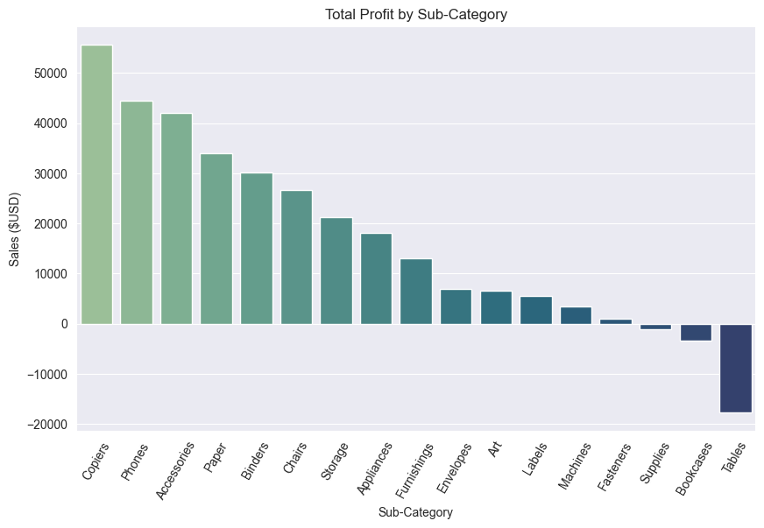
Copiers generate the most profit
Tables generate the least profit

Slide 27
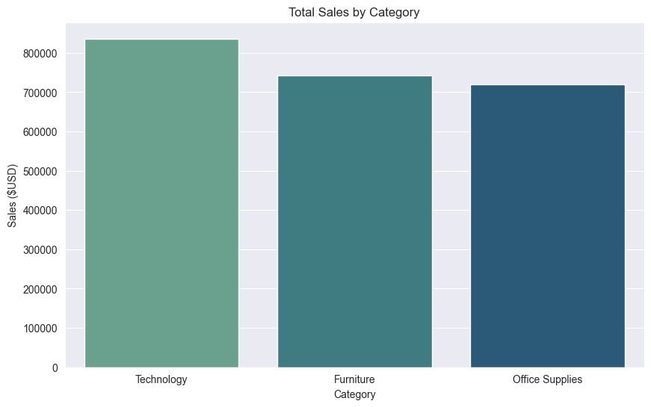
Technology generates the most sales

Slide 28
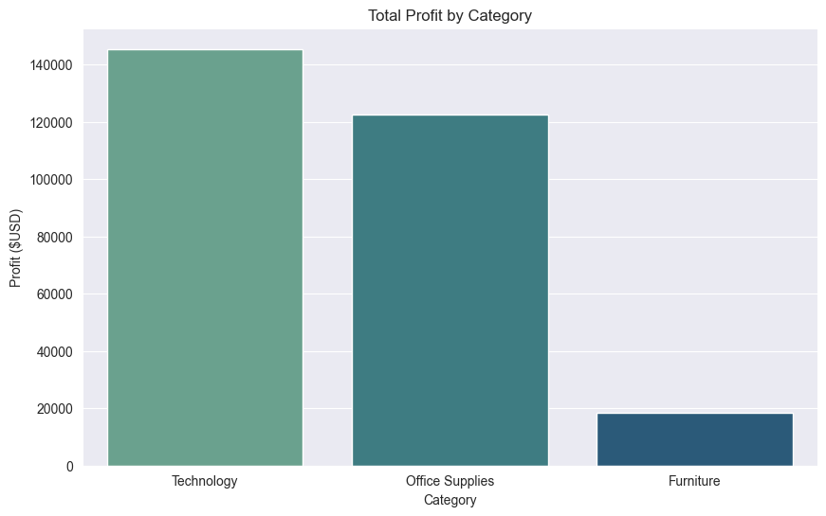
Technology has most profit

Slide 29
Analysis
2016 was a big year for both Sales and Profits, where we saw exponential Growth
Jacksonville, California is a critical location to focus for sales and profit
Technology sector was the biggest selling and copiers were the most profitable item

Slide 30
Conclusion
This superstore may want to focus more on what they did right in 2016 to boost sales and profit. Focusing on mainly the California, New York, and other big state locations while leaning more on the technology they are selling.

Slide 31
Thanks

